Slide 1
Link to Slides: goo.gl/TjpRnc
Notes:
Today we are going to be talking about digital accessibility processes and complexity within organizations. Our goal today is to sketch out some of our thinking, and to engage with the audience to discuss tools that can be used to understand how to do accessibility work, and what work has the greatest impact. Daniel Goldstein, our Keynote, talked through some of the things he was told were important. We’re going to think about that a bit today, and we’re also going to talk a little bit about frames for thinking about complex subjects in complex organizations.
Contact us:
Phil Deaton – deatonph@msu.edu
Nate Evans – ne@msu.edu

Slide 2
Developing Digital Accessibility Processes within a Complex Organization
Phillip J. Deaton – Digital Accessibility Coordinator, MSU IT
Nate Evans – Manager, MSU IT and MSU Hub
Notes:
Today we are going to be talking about digital accessibility processes and complexity within organizations. Our goal today is to sketch out some of our thinking, and to engage with the audience to discuss tools that can be used to understand how to do accessibility work, and what work has the greatest impact. Daniel Goldstein, our Keynote, talked through some of the things he was told were important. We’re going to think about that a bit today, and we’re also going to talk a little bit about frames for thinking about complex subjects in complex organizations.
Contact us:
Phil Deaton – deatonph@msu.edu
Nate Evans – ne@msu.edu

Slide 3
Agenda
Identify why process work benefits accessibility.
Recognize processes that support higher education and other complex organizations.
Demonstrate why prioritization and process improvement are core strategies to provide better user experiences to persons with disabilities.
Apply the Four-Frames model, and assess how you might apply it in your own context.
List of process resources/ideas to check out.
Notes:
Nate story – Halloween story
All of us here share the same sentiment, that’s why this conference is so amazing.
Complex organizations.
Map story – Don’t use a map of Tokyo

Slide 4
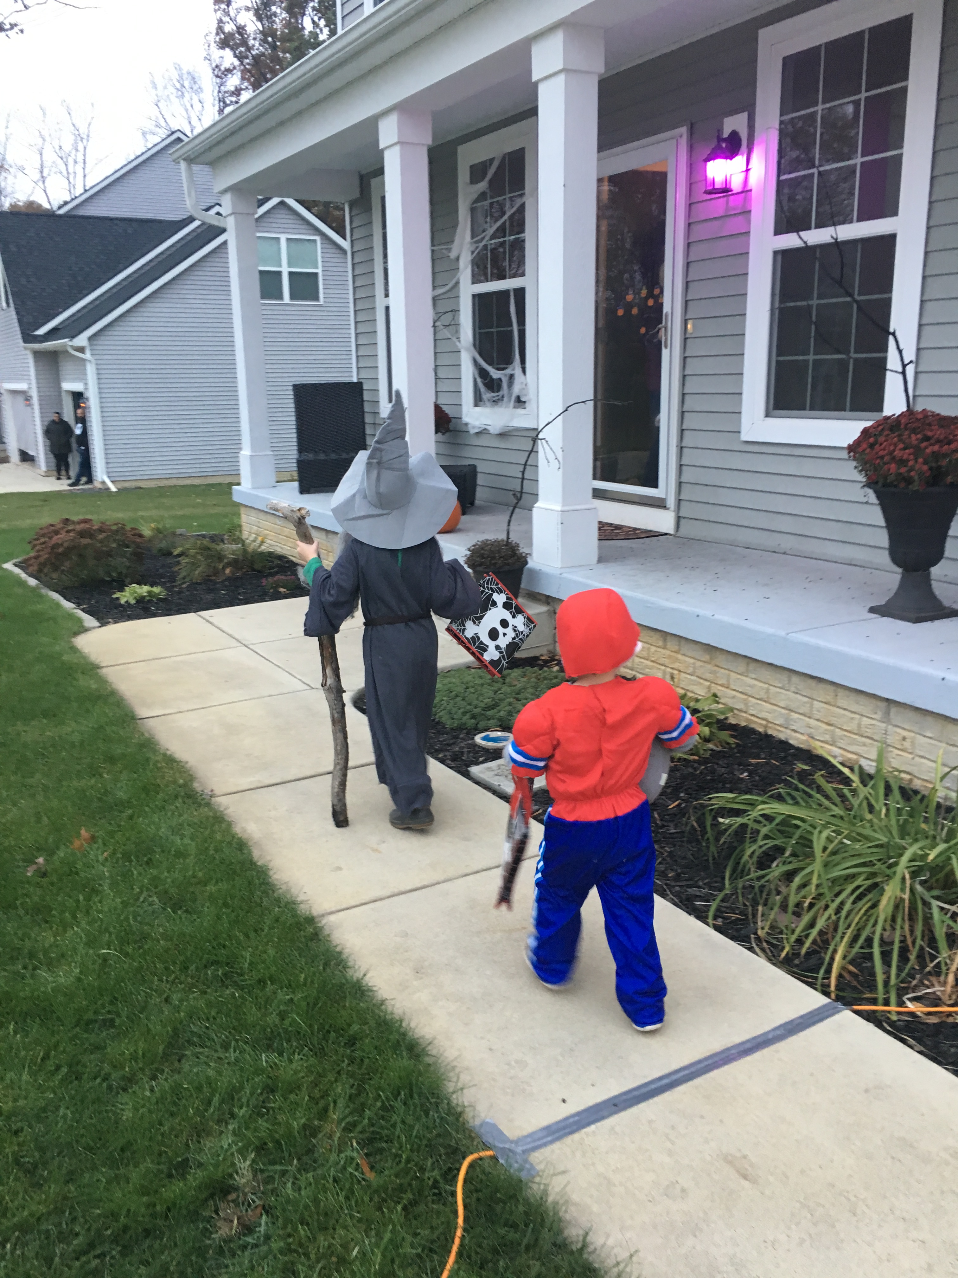
Welcome
Notes:
Nate story – Halloween story
All of us here share the same sentiment, that’s why this conference is so amazing.
Complex organizations.
Map story – Don’t use a map of Tokyo

Slide 5
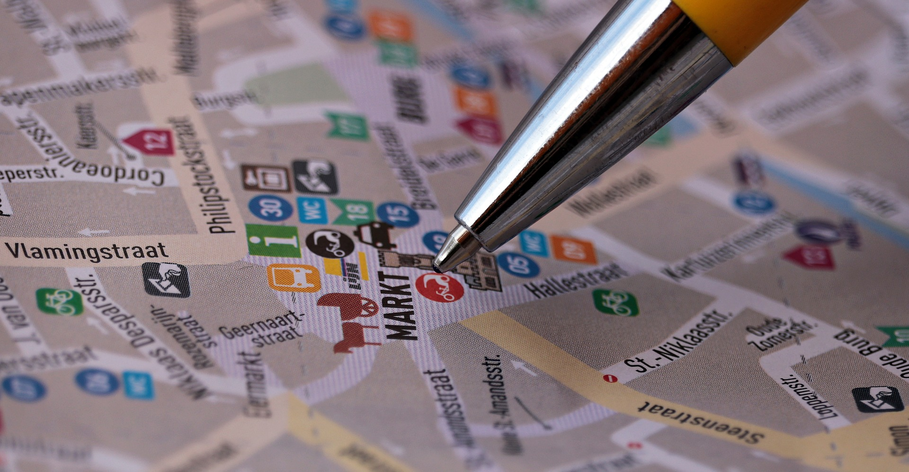
Map
Notes:
Image provided by Pixel2013 under the Creative Commons CC0 license: https://pixabay.com/en/street-map-map-search-to-find-2679271/
Complex organizations.
Map story – Don’t use a map of Tokyo

Slide 6
We need to understand cybernetics
"Cybernetics is a transdisciplinary approach for exploring regulatory systems—their structures, constraints, and possibilities"
-Wikipedia [1]
Notes:
Organizations are complex. Some organizations have a unified goal (to make money) whereas others might have this as a goal, but have separate missions dedicated towards advocacy, learning, research, or outreach. To understand organizations we have to understand this idea of cybernetics.
Define cybernetics, define frames generally
Describe what these terms mean and why they matter
How people use frames and why they use frames to understand complex organizations
Culture eats strategy for breakfast and ethics for dinner.
Lens metaphor, eye glass checker optometrist picture
Case – each group take a different frame and report out
Graphic of four frames/table

Slide 7
Why Examine Processes?
Notes:
How do you know if you are doing accessibility well in your organization? One way is to measure policies and procedures AKA processes (Daniel Goldstein mentioned this in his keynote).
Examining processes allows for us to make several moves
Make better existing models for providing accessibility in a variety of contexts
Understand organizational priorities related to accessibility
All organizations should spend significant energy on examining their mission & vision and goals, and understand how to ensure that accessibility practices align with the organizational mission, and how people use and move through the organization.
Frank Lloyd Wright blueprint Quote "The architect’s most effective tools are the eraser in the drafting room and the wrecking bar on the job"
Obviously erasing is an easier action than hammering. The idea is that we can efficiently use the limited resources that organizations allocate to accessibility. It's obviously cheaper to do it up front, but we find that we are always improving processes as we move forward, to the tune of Kaizen.
The reason we're thinking about processes is we're going to talk about how you can be savvy to affect and influence change related to accessibility using organizational thinking to influence the cybernetics of our organization.

Slide 8
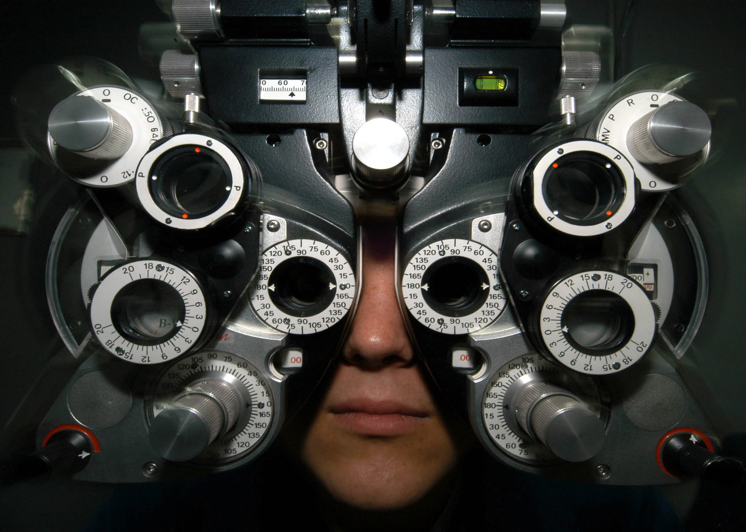
Frames for Organizational Thinking Four-Frame Model
[2] Person using a phoropter (optical refractor)
Notes:
People who research organizations tend to use a variety of paradigms for examining them. Due to the complexity of an organization, moving through multiple different lens helps to understand that organization. I’m going to talk briefly about frames for organizational thinking.
Lens metaphor, eye glass checker optometrist picture

Slide 9
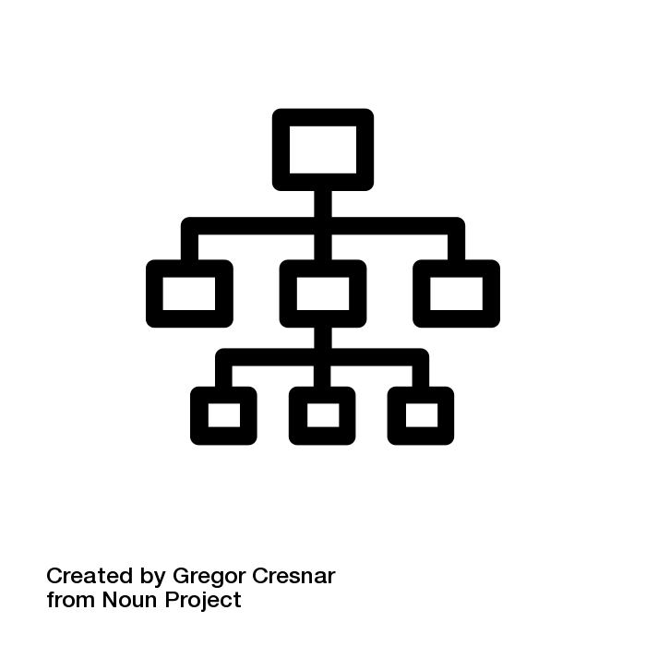
Structural Frame
Examining the organization as a network of structures and hierarchies
The "org chart" approach
Consider who makes decisions, who coordinates effort, ask the question "what is our goal" (Bolman & Deal, 2017, p. 99)
Think about why structures change
Think about how structures support people
Notes:
Phil
Organizations are a collection of individuals with similar interest. The structural frame is a way at looking the networks we create within organizations as structures. The structural frame uses org chart thinking to consider problems. Remember, this is one of our ways of looking at solutions to problems, and within heavily structurally influenced organizations, definitely a useful tool for your toolbox.
Ask questions like: what is our organization's goal, how do I align with business goals and business needs, how do I create structures which support accessibility, do the structures which I work in support accessibility? And another question you can ask if how can I lever pre-existing structures to influence accessibility.
goals change, contexts change, technologies change, leadership changes, organizations change. Think about the relationship between the organization and the individual and how the organization structures individuals to communicate and work.
Example of how we've used it: If an individual stakeholder is not down to do accessibility work, then we work through our hierarchies and have the ADA Coordinator at our University say that this happens.
So the way to use the structural frame is to consider how we do accessibility work. At MSU our accessibility team report in a three-pronged way to Legal Counsel, Institutional Equity (ADA Coordinator) and MSU Information Technology. Then we have a distributed work model where each division has an accessibility liaison. We explain these structures and get people involved at various levels depending on what type of accessibility work we are doing.
Describe what these terms mean and why they matter
How people use frames and why they use frames to understand complex organizations
Culture eats strategy for breakfast and ethics for dinner.
Lens metaphor, eye glass checker optometrist picture
Case – each group take a different frame and report out
Graphic of four frames/table

Slide 10
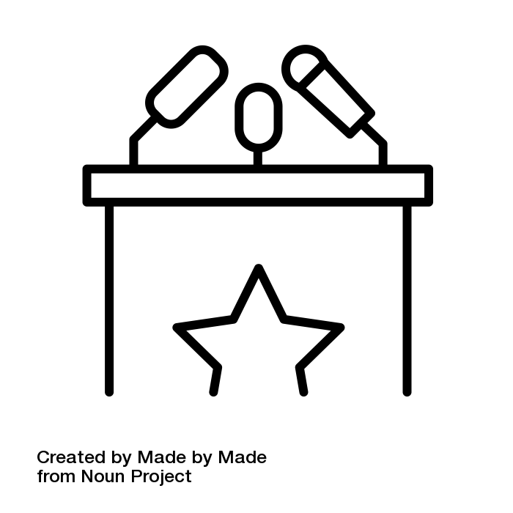
Political Frame
The political frame as being intrinsically linked with power dynamics within an organization (Bolman & Deal, 2017, 183-184)
The "ambassador" approach
Importance of coalition building (p. 188)
It is not enough to institute policies, procedures, and practices
Organization as "arena", before entering the arena build support
Nemawashi, gather allies and support
Notes:
Phil write this
6% of individuals were able to correctly answer which things were covered by our web accessibility policy from a division at MSU.
Nemawashi- quietly lay groundwork/foundation for change https://en.wikipedia.org/wiki/Nemawashi
Structural frame is top-down, political frame encourages us to think about bottom-up and the percolation of grassroots ideas
Are you trying to roll out a new policy or procedure on campus? Make sure you build buy-in, and not just from the top-down.
Describe what these terms mean and why they matter
How people use frames and why they use frames to understand complex organizations
Culture eats strategy for breakfast and ethics for dinner.
Lens metaphor, eye glass checker optometrist picture
Case – each group take a different frame and report out
Graphic of four frames/table

Slide 11

Human Resources Frame
Looking at the organization through the needs and motivations of the people within the organization
The "people-first" approach
Think about individual motivation, and relationship between individual and organization
Invest in and empower people, while promoting diversity (p. 140)
Encourage autonomy, mastery, and purpose (p. 121)
Theory X versus Theory Y (p. 123)
Notes:
Phil write this
The structural frame encourages you to think about the relationship between the organization and the individual hierarchically.
(not organization and individual)
Theory X – subordinates are passive or lazy
Theory Y – subordinates are self-directed
People are more likely to want to learn than they are to hear about laws or polcies or who you report to.
Talk about liaisons
Describe what these terms mean and why they matter
How people use frames and why they use
frames to understand complex organizations
Culture eats strategy for breakfast and ethics for dinner.
Lens metaphor, eye glass checker optometrist picture
Case – each group take a different frame and report out
Graphic of four frames/table

Slide 12

Symbolic Frame
Meaning is not given to us; we create it (Bolman & Deal, 2017, 244)
The "culture-first" approach
Symbols shape vision and value more than any individual ever could (p. 249–250)
Symbols and brand change slowly
People that are part of organizations become connected with symbols
Symbols influence relationships as much as they do people (p. 284)
Organizations are theaters to be acted in (p. 291)
Notes:
Phil write this
The Symbolic frame thinks about organizations from a constructivist viewpoint. Mention MSU basketball team and logo as a symbol. This is a brand argument our lawyers and compliance folks are clever and say this.
Describe what these terms mean and why they matter
How people use frames and why they use frames to understand complex organizations
Culture eats strategy for breakfast and ethics for dinner.
Lens metaphor, eye glass checker optometrist picture
Case – each group take a different frame and report out
Graphic of four frames/table

Slide 13
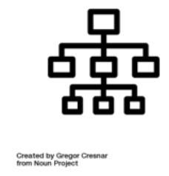
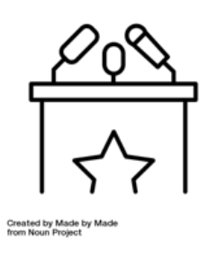

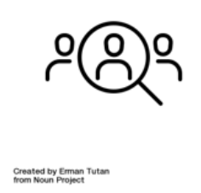
Four-Frames Model
 | Structural | Human Resources | Political | Symbolic
Metaphor for Organization | Factory or machine | Family | Jungle | Carnival, temple, theater
Central Concepts | Roles, goals, policies, technology, environment | Needs, skills, relationships | Power, conflict, competition, politics | Culture, meaning, metaphor, ritual, story
Image of Leadership | Social architecture | Empowerment | Advocacy and political savvy | Inspiration
Basic Leadership Challenge | Attune structure to task, technology, environment | Align organizational and human needs | Develop agenda and power base | Create faith, beauty, meaning, ceremony, heroes
Adapted from Figure 1.1 Bolman & Deal (2017, p. 19) [3]
Notes:
Phil write this
You'll notice that each of these icons
Describe what these terms mean and why they matter
How people use frames and why they use frames to understand complex organizations
Culture eats strategy for breakfast and ethics for dinner.
Lens metaphor, eye glass checker optometrist picture
Case – each group take a different frame and report out
Graphic of four frames/table

Slide 14
Activity
Share a current accessibility challenge within your organization where your approach has been unsuccessful.
Structural
Political
HR
Symbolic
What frame did you use?
What alternative frame/approach might work instead?

Slide 15
General Learnings at MSU
Four frames using the study at MSU
General Tips
Symbolic value: do not anchor accessibility programs in things you cannot control like legal complaints or lawsuits, anchor them to symbols (brand) and business value
Human resources: accessibility initiatives are about people, get more people involved
Political value: everyone is a potential ally and advocate, use the frames to appeal to stakeholders

Slide 16
Resources for Process Analysis
Six Sigma
Kaizen
Frames (Bolman & Deal)
Value stream mapping
User Experience Strategy conversations
Higher education administration conversations

Slide 17
Contact
Landscape survey of digital accessibility professionals in higher education (Qualtrics): http://bit.ly/2FU7HWo (also you can find on my Twitter)
Phil Deaton Digital Accessibility Coordinator Michigan State University deatonph@msu.edu
@deatonphil
webaccess.msu.edu
Nate Evans Manager, Digital Content & Accessibility Michigan State University ne@msu.edu
@nateevans webaccess.msu.edu

Slide 18
Works Cited
https://pixabay.com/en/street-map-map-search-to-find-2679271/
https://en.wikipedia.org/wiki/Cybernetics
https://commons.wikimedia.org/wiki/File:Geraet_beim_Optiker.jpg
Bolman, L. G., & Deal, T. E. (2017). Reframing organizations: Artistry, choice, and leadership. John Wiley & Sons.

